Slide 1
JNCIS-ENT
Layer 2 switching and VLANs

Slide 2
L2 Troubleshooting and Maintenance
7
L2 configuration and maintenance commands

Slide 3
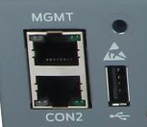
EX Management Interfaces
EX Series switches provide an OOB management interface me0 along with the console serial port.
Configure an IP on the me0 interface for remote OOB management
{master:0}[edit interfaces]
user@Switch# show me0
unit 0 {
family inet {
address 10.0.0.10/24;
}
}
me0 interface
Serial interface

Slide 4
Enable L2 Switching
Use the family ethernet-switching command on an interface or interface range to enable basic L2 switching functionality.
{master:0}[edit interfaces]
user@Switch# show
ge-0/0/0 {
unit 0 {
family ethernet-switching;
}
}
ge-0/0/1 {
unit 0 {
family ethernet-switching;
}
}
…
{master:0}[edit interfaces]
user@Switch# show
interface-range switchports-1 {
member ge-0/0/0;
member ge-0/0/1;
member ge-0/0/2;
unit 0 {
family ethernet-switching;
}
}
…

Slide 5
EX Interface Status
Use the show interfaces terse command to verify interface status and mode
{master:0}
user@Switch> show interfaces terse | match “interface|0/0|0/1”
Interface Admin Link Proto Local Remote
ge-0/0/0 up up
ge-0/0/0.0 up up eth-switch
ge-0/0/1 up up
ge-0/0/1.0 up up eth-switch

Slide 6
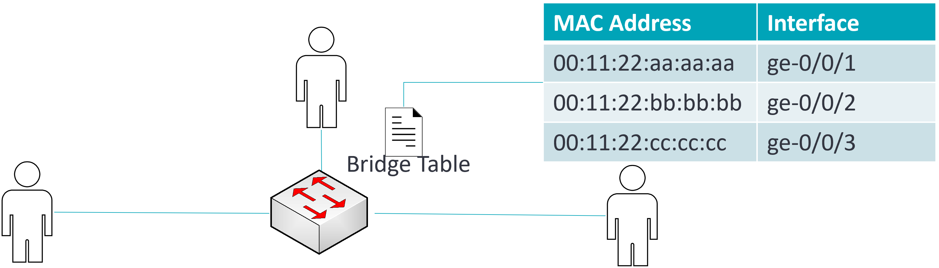
Bridge Table Status
Use the show ethernet-switching table command to view the contents of the bridge table
{master:0}
user@Switch> show ethernet-switching table
…
Ethernet switching table : 3 entries, 3 learned
Routing instance : default-switch
Vlan MAC MAC Age Logical
name address flags interface
default 00:11:22:aa:aa:aa D - ge-0/0/1.0
default 00:11:22:bb:bb:bb D - ge-0/0/2.0
default 00:11:22:cc:cc:cc D - ge-0/0/3.0
Switch

Slide 7
MAC Forwarding Table Status
Use the show route forwarding-table family ethernet-switching command to view the contents of the forwarding table
{master:0}
user@Switch> show route forwarding-table family ethernet-switching
Routing table: default-switch.bridge
VPLS:
Destination Type RtRef Next hop Type Index NhRef Netif
default perm 0 dscd 1300 1
ge-0/0/0.0 intf 0 ucst 1332 4 ge-0/0/0.0
ge-0/0/1.0 intf 0 ucst 1333 6 ge-0/0/1.0
Routing table: default-switch.bridge
Bridging domain: v950.bridge
VPLS:
Enabled protocols: Bridging, ACKed by all peers,
Destination Type RtRef Next hop Type Index NhRef Netif
00:03:00:00:00:a0/48 user 0 ucst 1333 6 ge-0/0/1.0
00:03:00:00:fc:96/48 user 0 ucst 1332 4 ge-0/0/0.0

Slide 8
Clear Bridging Table
Use the clear ethernet-switching table command to clear entries from the bridge table
{master:0}
user@Switch> show ethernet-switching table
…
Ethernet switching table : 2 entries, 2 learned
Routing instance : default-switch
Vlan MAC MAC Age Logical NH RTR
name address flags interface Index ID
v950 00:a0:9c:01:bf:1c D - ge-0/0/1.0 0 0
v950 fc:96:43:88:f2:26 D - ge-0/0/0.0 0 0
{master:0}
user@Switch> clear ethernet-switching table interface ge-0/0/1
{master:0}
user@Switch> show ethernet-switching table
…
Ethernet switching table : 1 entries, 1 learned
Routing instance : default-switch
Vlan MAC MAC Age Logical NH RTR
name address flags interface Index ID
v950 fc:96:43:88:f2:26 D - ge-0/0/0.0 0 0

Slide 9
Defining Static Table Entries
Static bridge table entries can be defined under the [edit vlans] hierarchy of the configuration.
{master:0}[edit vlans]
user@Switch# show
v950 {
vlan-id 950;
switch-options {
interface ge-0/0/2.0 {
static-mac 00:11:22:33:44:55;
}
}
}
{master:0}
user@Switch> show ethernet-switching table
…
Ethernet switching table : 2 entries, 2 learned
Routing instance : default-switch
Vlan MAC MAC Age Logical NH RTR
name address flags interface Index ID
v950 00:a0:9c:01:bf:1c D - ge-0/0/1.0 0 0
v950 fc:96:43:88:f2:26 D - ge-0/0/0.0 0 0
v950 00:11:22:33:44:55 S - ge-0/0/2.0 0 0

